Slide 1
Balanced Search Trees
How long does it take to determine whether a particular value x appears in an ordered tree T containing n nodes?
Worst case time is O(h), where h is the height of T
Minimum height (T is balanced):
Maximum height (T is lopsided):
Key idea: Keep the tree balanced (prevent it from getting lopsided)
A ≤ ≤ B ≤ ≤ C
h = ⎣log₂ n⎦
h = n − 1
Rotate right
C
Left Left
A
Right Right
Rotate left
A
B
B
C

Slide 2

Dealing with Left Right and Right Left
Do a double-rotation!
Rotate right
Rotate left
C
C
A
B₂
A
B₁
B₂
C
B₁
B₂
A
B₁
AVL Trees: Ensure that height
difference between left and
right sub-trees is at most 1

Slide 3
AVL Tree Implementation
typedef struct node {
int data; /* or some other type */
struct node *left;
struct node *right;
int height;
} tNode;
int h(tNode *node) {
return node == NULL ? -1 : node->height;
}
tNode *makeNode(int D, tNode *L, tNode *R) {
tNode *node = (tNode *) malloc(sizeof(tNode));
...
node->height = 1 + MAX(h(L), h(R));
return node;
}

Slide 4
Insert in an AVL tree
tNode *rec_ins(tNode *node, tNode *newNode) {
if(node == NULL) { return newNode; }
if(newNode->data < node->data) {
node->left = rec_ins(node->left, newNode);
if(h(node->left) > h(node->right)) {
node->height = h(node->left) + 1;
}
} else if(newNode->data > node->data) {
node->right = rec_ins(node->right, newNode);
if(h(node->right) > h(node->left)) {
node->height = h(node->right) + 1;
}
}
return balance(node);
}
tNode *insert(tNode *node, int D) {
if(find(node, D)) { return NULL; }
tNode *newNode = makeNode(D, NULL, NULL);
if(newNode == NULL) { return NULL; }
return rec_ins(node, newNode);
}

Slide 5
Balancing nodes in an AVL tree
tNode *balance(tNode *node) {
if(node == NULL) { return NULL; }
if(h(node->left) > h(node->right)+1) {
if(h(node->left->left) > h(node->left->right) {
return handleLL(node);
} else {
return handleLR(node);
}
} else if(h(node->right) > h(node->left)+1) {
if(h(node->right->right) > h(node->right->left)) {
return handleRR(node);
} else {
return handleRL(node);
}
} else { return node; }
}

Slide 6
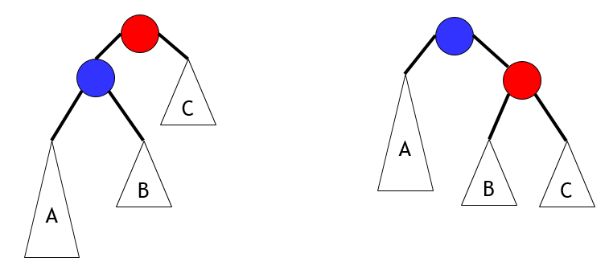
handleLL
tNode *handleLL(tNode *node) {
tNode *A, *B, *C, *result;
result = node->left;
A = result->left;
B = result->right;
C = node->right;
result->right = node;
node->left = B;
node->height = 1 + MAX(h(B), h(C));
result->height = 1 + MAX(h(A), node->height);
return result;
}
O(1) time
Hence, balance() is also O(1) time
Thus, insert is O(h)
We will prove that h is O(log n)
node
result

